Slide 1
Graph2Seq: Graph to Sequence Learning With Attention-based Neural Networks
Kun Xu, Zhiguo Wang, Michael Witbrock, Lingfei Wu, Yansong Feng, Vadim Sheinin
IBM Research Group

Slide 2
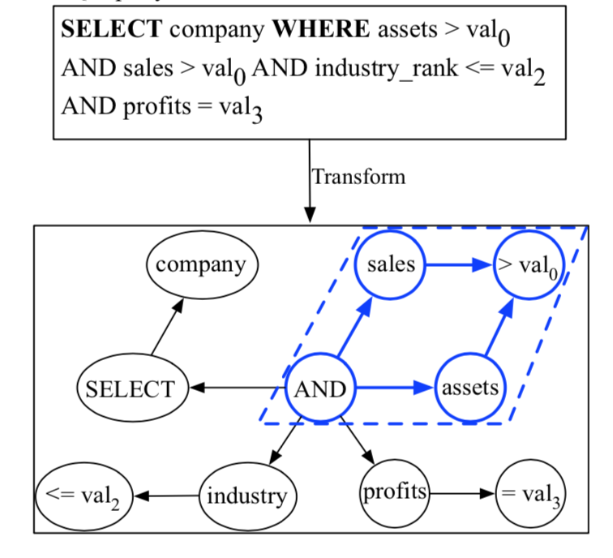
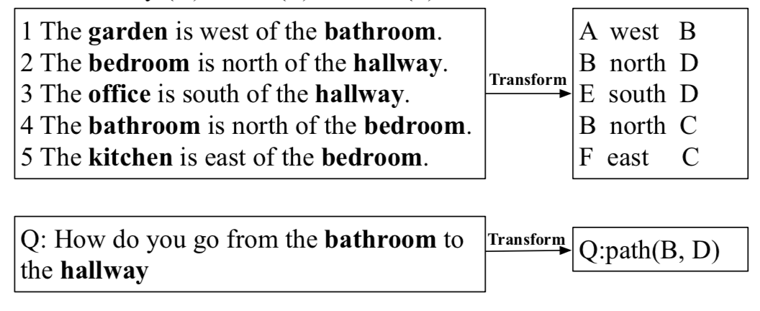
Motivations
Structured Data
Task1: SQL query description generation
Task2: Geographical Path Finding
Notes:
given a set of sentences describing the relative geographical positions for a pair of objects o1 and o2, we aim to find the geographical path between o1 and o2.

Slide 3
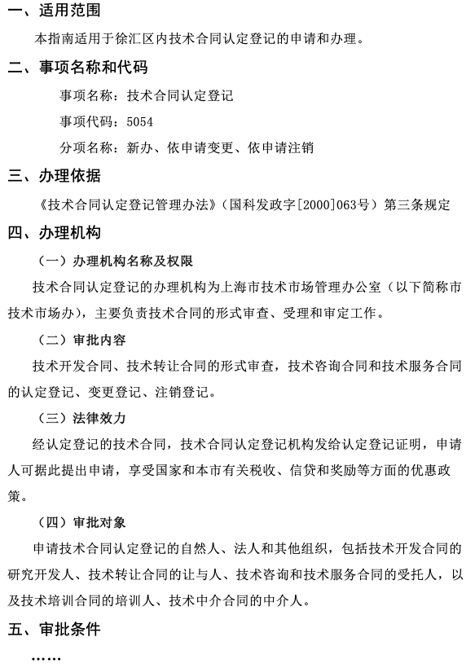
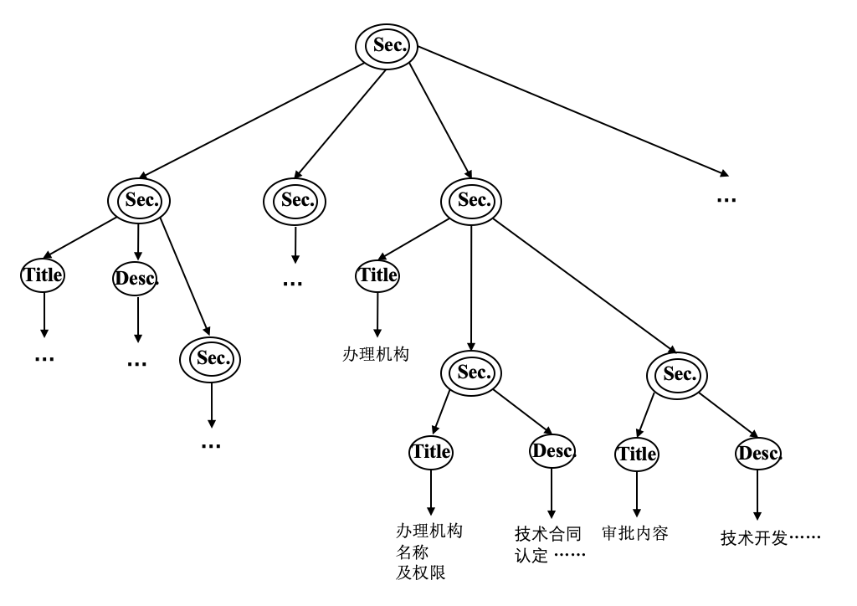
Motivations
Structured Data
Our Task: Structured Document Question Generation

Slide 4

Task Definition
Task Definition
Graph Encoder
Seq Decoder
B
A
$$w_{1},w_{2},w_{3},w_{4},…,w_{N}$$
D
C
E
F

Slide 5
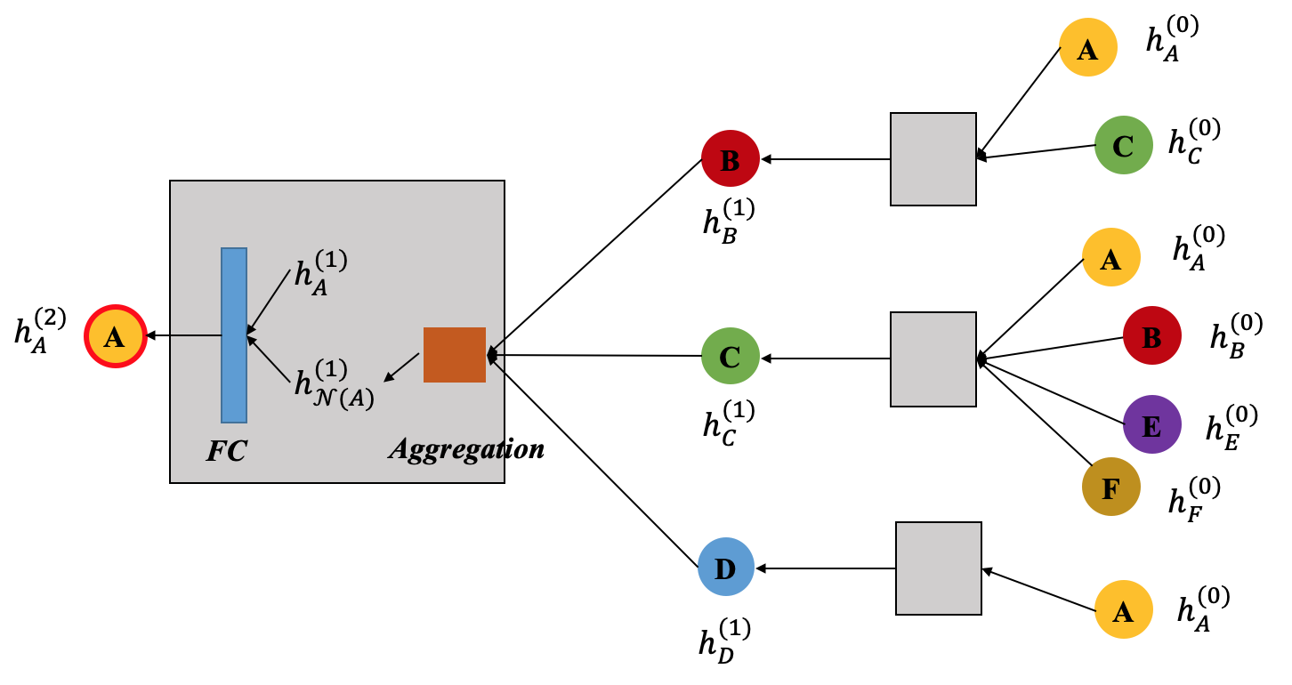
Model Architecture
Node Embedding
B
A
D
C
E
F
Graph
Node Embedding Algorithm Visualization

Slide 6







Model Architecture
Node Embedding Algorithm
Forward Neighbors:
$$𝒩_{⊢}\left(A\right)=\{B, D\}$$
B
$$h_{𝒩_{⊢}(A)}^{k}=Aggregate(h_{⊢B}^{k−1},h_{⊢D}^{k−1})$$
A
$$h_{⊢A}^{k}=σ(W^{k}[h_{⊢A}^{k};h_{𝒩_{⊢}(A)}^{k}])$$
Backward Neighbors:
D
C
$$𝒩_{⊣}\left(A\right)=\{C,E\}$$
E
$$h_{𝒩_{⊣}(A)}^{k}=Aggregate(h_{⊣C}^{k−1},h_{⊣E}^{k−1})$$
F
$$h_{⊣A}^{k}=σ(W^{k}[h_{⊣A}^{k};h_{𝒩_{⊣}(A)}^{k}])$$
Node Embedding:
Graph
$$z_{A}=[h_{⊢A}^{k};h_{⊣A}^{k}]$$

Slide 7
Model Architecture
Aggregation Methods
1. Mean Aggregator: Element-wise mean of the vectors in Forward vectors and Backward vectors
2. LSTM Aggregator: Use LSTMs to operate on unordered sets by simply applying them to a single random permutation of the node neighbors.
3. Pooling Aggregator: Each neighbor’s vector is fed through a fully-connected neural network, and an element-wise max-pooling operation is applied.

Slide 8
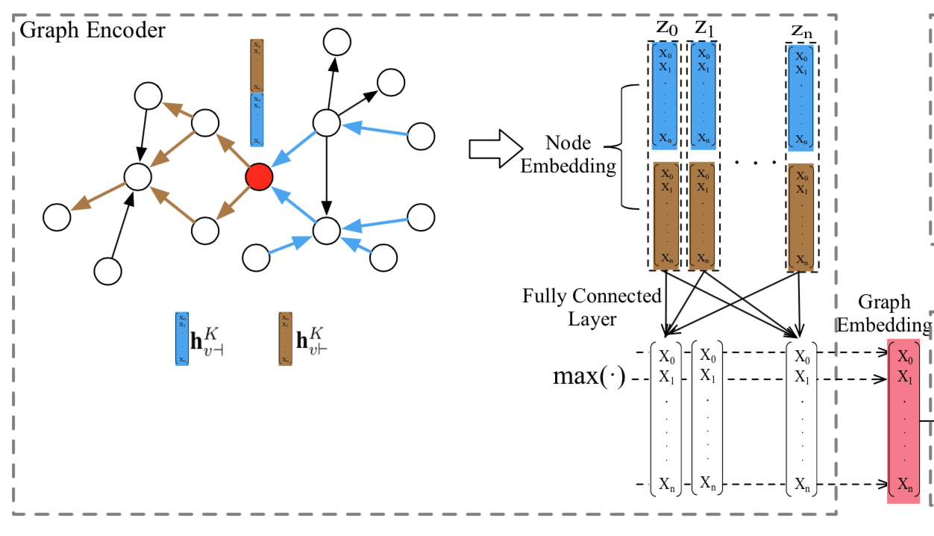
Model Architecture
Graph Embedding
Method 1: Pooling-based Graph Embedding
Method 2: Node-based Graph Embedding

Slide 9
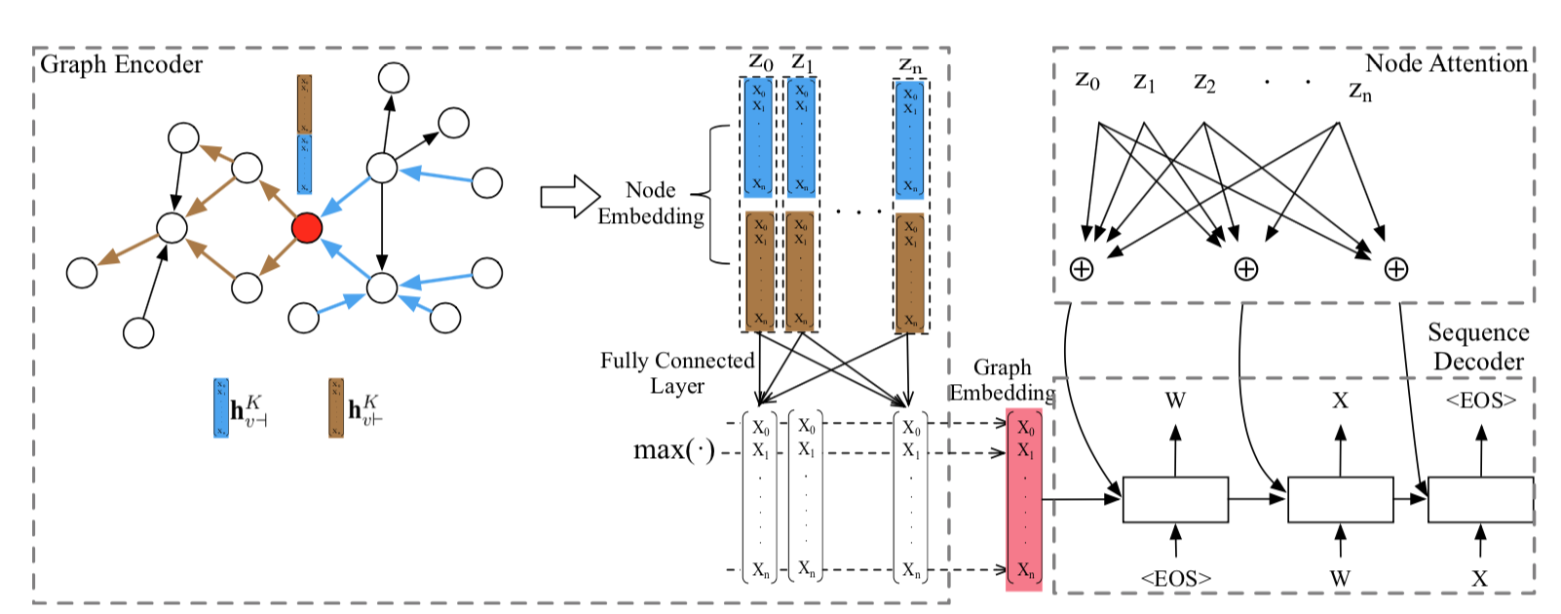
Model Architecture
Attention-based Decoder

Slide 10
Thinking
The difference between Tree-LSTM and GCN
A
A
B’s node embedding only contains information from C.
B’s node embedding contains information both from A and C.
D
B
B
D
E
F
C
E
F
C
Tree-LSTM: Unidirectional
GCN: Bidirectional

Slide 11
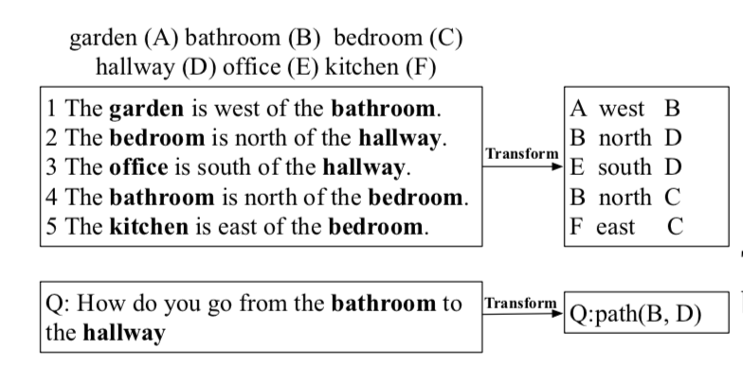
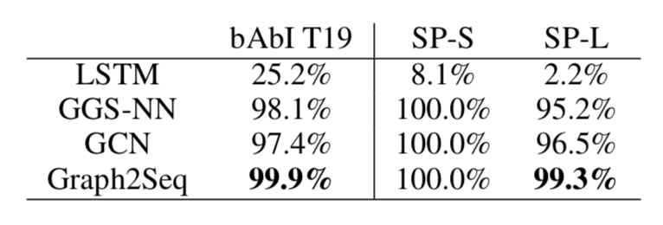
Experiments
Task 1: bAbI Task 19 (Path Finding)
Graph
Trick: Assign the edge’s text as node’s text attribute
Notes:
GCN: undirected graph

Slide 12
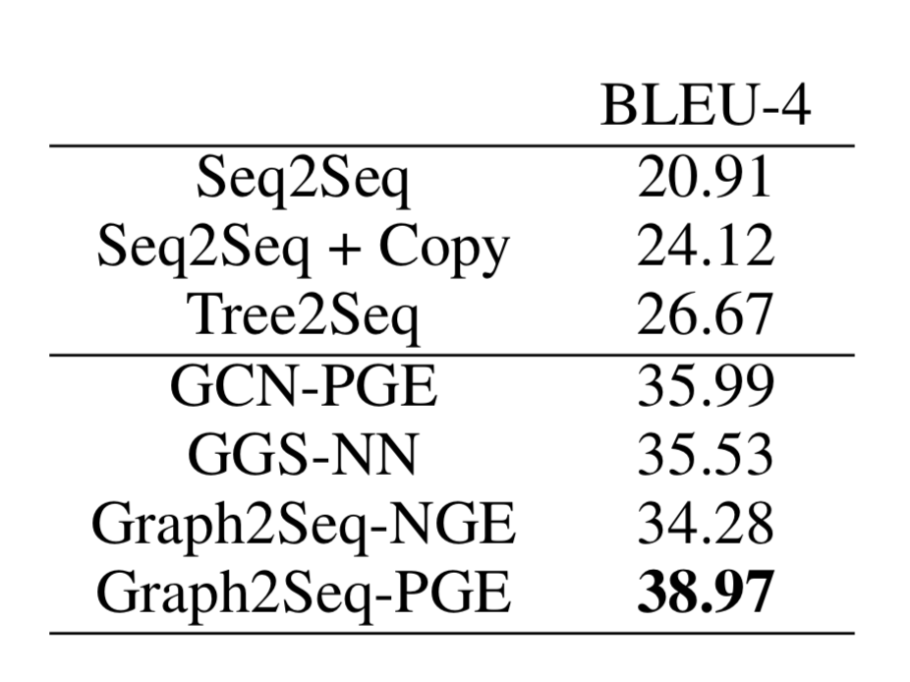
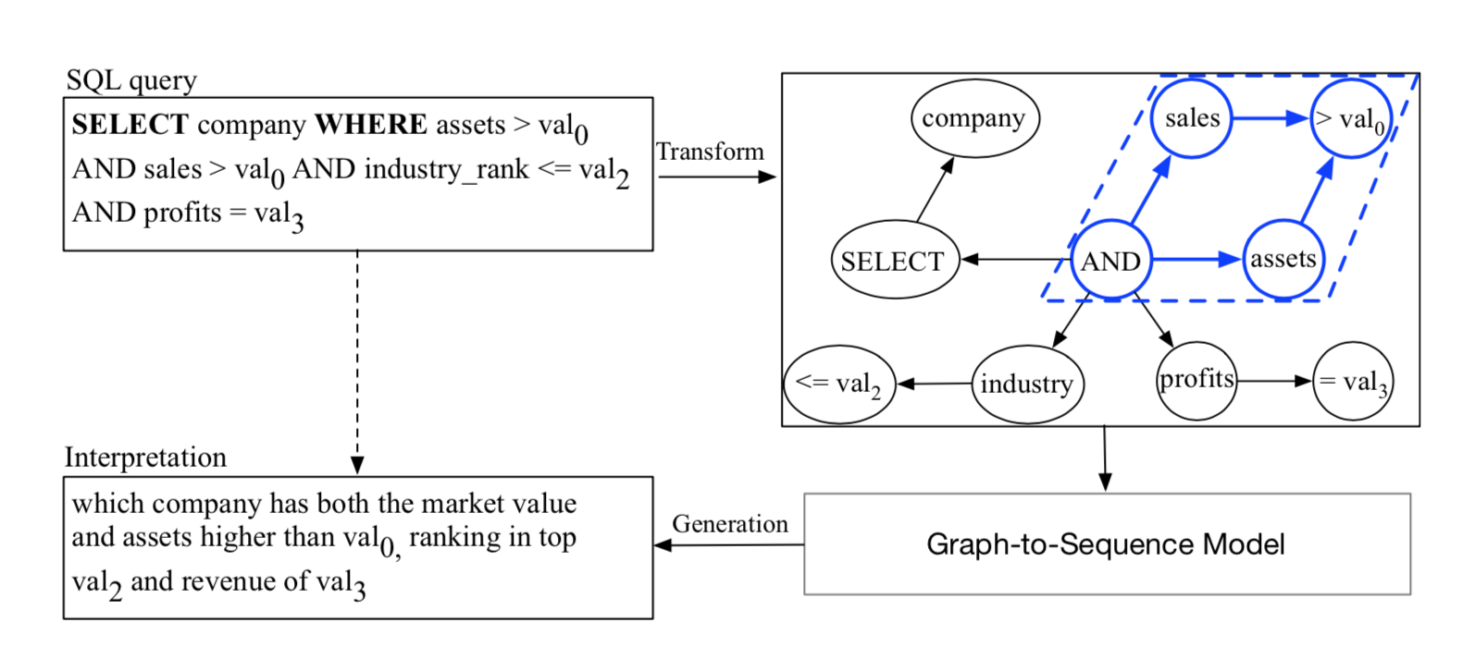
Experiments
Task 2: Natural Language Generation Task
Dataset: WikiSQL
Description: 87,726 hand-annotated instances
Task: Generation SQL query description
* NGE: Node-based Graph Embedding
* PGE: Pooling-based Graph Embedding
Notes:
NGE < PGE: added a super node in graph which changes the original graph topology and brings un- necessary noise into the graph.

Slide 13
Knowledge Take-Away
Conclusion:
This paper proposed a novel graph-to-sequence model.
The graph encoder in this paper is bidirectional.
The improvement from Tree2Seq to Graph2Seq may result from the bidirectional mechanism in Graph2Seq model.
Notes:
GCN: undirected graph

Slide 14
Thank you ☺
Notes:
GCN: undirected graph

Slide 15












A
$$h_{A}^{(0)}$$
B
C
$$h_{C}^{(0)}$$
$$h_{B}^{(1)}$$
A
$$h_{A}^{(0)}$$
$$h_{A}^{(1)}$$
$$h_{A}^{(2)}$$
A
B
$$h_{B}^{(0)}$$
C
$$h_{𝒩(A)}^{(1)}$$
$$h_{C}^{(1)}$$
E
$$h_{E}^{(0)}$$
FC
Aggregation
F
$$h_{F}^{(0)}$$
D
A
$$h_{A}^{(0)}$$
$$h_{D}^{(1)}$$

